Slide 1
The Battle of the Neighborhoods
By : Paula Maranon

Slide 2
Introduction and Problem Description:
Capstone project: Battle of the neighborhoods
Recommendation of the neighbourhood in Toronto to open a Spanish restaurant.
As a Spanish living in Toronto, I am studying the possibility to open a Spanish restaurant in Toronto where people could enjoy well elaborated food. As I need as many people as possible to come to the restaurant, choosing the right location is crucial to the business.

Slide 3
Data Sources, Data Processing , Tools used
Postal codes of different neighbourhoods in Canada will be retrieved from this website https://en.wikipedia.org/wiki/List_of_postal_codes_of_Canada:_M
Location coordinates of different neighborhoods will be retrieved from this site: https://cocl.us/Geospatial_data
Finally, I will use the FourSquare API to explore different neighborhoods in Toronto. The Foursquare explore function will be used to get the most popular venues in each neighborhood.
The Tools: Web-scraping of sites is used to consolidate data-frame information which was saved as csv files for convenience and to simply the report. Geodata was obtained by coding a program to use Nominatim to get latitude and longitude of borough or neighborhood.
Geopy_distance and Nominatim were used to establish relative distances. Seaborn graphic was used for general statistics on rental data.
Maps with popups labels allow quick identification of location, price and feature, thus making the selection very easy.

Slide 4
Methodology
Methodology
The postal codes of different neighborhoods in Toronto will be collected by Web scraping (HTTP request). Data will be cleaned and selected by Beautiful Soup library. After that, the geographical coordinates, latitude, and longitude will be retrieved by using the Google API. The neighborhood with name, postal code, geographical coordinates will be regrouped and cleaned by Pandas library. Then FourSquare API will be called to retrieve all the venues in different neighborhoods.

Slide 5
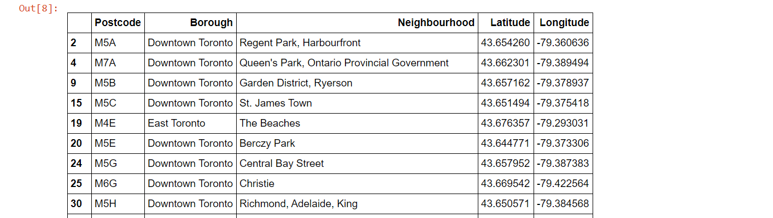
Execution and Results
Post codes, latitudes and longitudes for various neighbourhoods in Canada

Slide 6
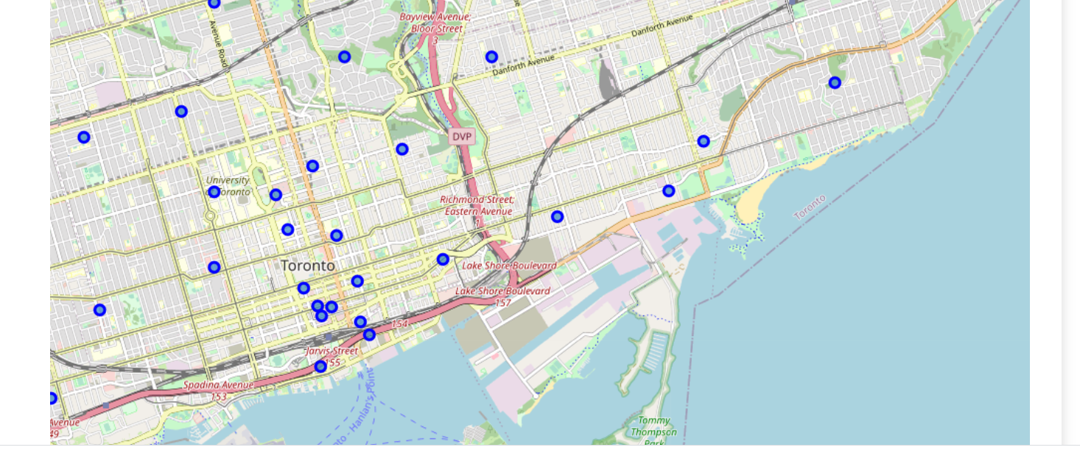
Execution and Results
Visualizing all the Neighbourhoods

Slide 7
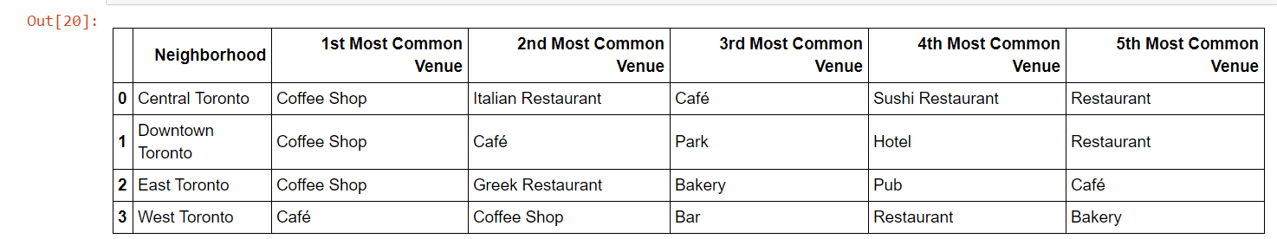
Execution and Results
Venues: The top 5 venues for each neighbourhood

Slide 8
Conclusion
Based on Four Square API search result, we can see that coffee shops and restaurants venue categories are the most common venues in the different neighbourhoods. Which means that people usually eat out. Among all the venues there is none Spanish restaurant listed and it is known that more than 70,000 people living in Toronto list Spanish as their Mother Tongue.
Among of all neighbourhoods, Downtown Toronto is the city with more boroughs and probably the most populated city, thus, is probably the best neighbourhood to open a restaurant. This result of this analysis has some limitations. It cannot reflect the behaviour of the customer in that area. People like to visit the restaurants or stop by the coffee shops does not mean they want Spanish food. The customers may enjoy the fact of trying new dishes, more than just having the typical Chinese or Canadian food. Rental cost has not been taken into account either. Downtown Toronto may be the most expensive rental area in Toronto.

